Slide 1
Social Dynamics and Math Discussions:
Practical Strategies to Have Students, “Construct Viable Arguments and Critique the Reasoning of Others”
Common Core Mathematical Practice Standard 3
Benjamin Walker and Joseph Herbert (Math for America DC)
Teacher Leadership Program | Park City Mathematics Institute (PCMI) 2015

Slide 2
Goals: Participants will...
Identify and investigate challenges to creating meaningful student-to-student interactions
Create norms, structures, and routines that will promote mathematical discourse in their classroom

Slide 3
Please write your name on the notecard and hand it back

Slide 4
Warm Up
On a scale of 1-10, how important is it for students to talk to each other about math?
On a scale of 1-10, how hard is it to make this happen effectively?
Write at least one challenge to creating effective student discourse in the classroom.

Slide 5
Brainstorm
What are the biggest hurdles that prevent students from having meaningful discourse in your classroom?

Slide 6
Random Groupings!

Slide 7
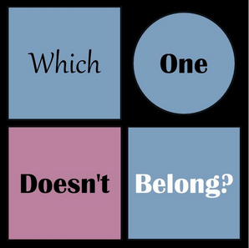
What is an ideal student response to this question?
Source: http://wodb.ca/

Slide 8
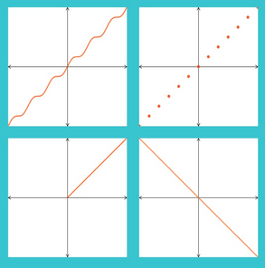
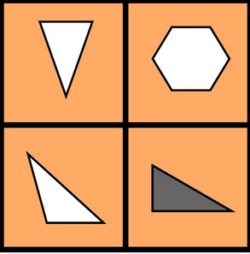
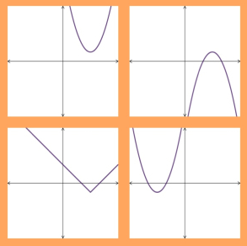
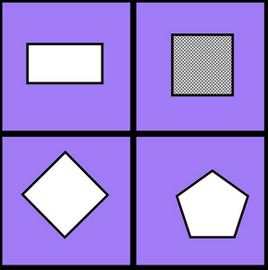
Choose ONE image from each set that does not belong. Be prepared to explain and justify your choice.
Source:
http://wodb.ca/
Convince yourself
Convince a friend
Convince a skeptic

Slide 9
Vignette
What do you think Ilana Horn means by “benign dominance”?
How does it affect student learning?

Slide 10
“Status is the perception of students’ academic capability and social desirability.”
“The word perception is key to this definition….Perception involves our expectations of what people (including ourselves) have to offer.”
What are some ways that status can inhibit classroom discourse?
Horn, Ilana (2012). Strength in Numbers: Collaborative Learning in Secondary Mathematics (p. 21). Nashville, TN: NCTM.
Also available on Ilana Horn’s blog teachingmathculture.wordpress.com: https://teachingmathculture.wordpress.com/2014/03/05/status-the-social-organization-of-smartness/

Slide 11
Status Interventions
Establishing and Maintaining Norms
Classroom norms communicate how students learn, not (only) how they should behave.
What are some classroom norms that facilitate student discourse by promoting the idea that every student has something to offer?

Slide 12
Status Interventions
Establishing and Maintaining Norms
Possible classroom norms:
Take turns.
Listen to others’ ideas.
Disagree with ideas, not people.
Be respectful.
Helping is not the same as giving answers.
Confusion is part of learning.
Say your “becauses.”
Horn, Ilana (2012). Strength in Numbers: Collaborative Learning in Secondary Mathematics (p. 28). Nashville, TN: NCTM.
Also available on Ilana Horn’s blog teachingmathculture.wordpress.com: https://teachingmathculture.wordpress.com/2014/03/24/recognizing-smartness-and-addressing-status-in-the-classroom/

Slide 13
Status Interventions
Establishing and Maintaining Norms
Reflect: How could you use “Which One Doesn’t Belong?” to highlight and reinforce specific classroom norms to help mitigate status issues?

Slide 14
Status Interventions
2. Assigning Competence
“Assigning competence is a form of praise where teachers catch students being smart. The praise is public, specific to the task, and intellectually meaningful.”
Mathematical competence is multidimensional. What qualifies as being “smart at math?”
Horn, Ilana (2012). Strength in Numbers: Collaborative Learning in Secondary Mathematics (p. 31). Nashville, TN: NCTM.
Also available on Ilana Horn’s blog teachingmathculture.wordpress.com: https://teachingmathculture.wordpress.com/2014/03/24/recognizing-smartness-and-addressing-status-in-the-classroom/

Slide 15
Status Interventions
2. Assigning Competence
public, specific to the task, intellectually meaningful
“The public part of assigning competence means that this praise is not an aside to an individual student or a communication with the parent. It takes place in the public realm of the classroom, whether in a small-group activity or whole-class discussion.”
Horn, Ilana (2012). Strength in Numbers: Collaborative Learning in Secondary Mathematics (p. 32). Nashville, TN: NCTM.
Also available on Ilana Horn’s blog teachingmathculture.wordpress.com: https://teachingmathculture.wordpress.com/2014/03/24/recognizing-smartness-and-addressing-status-in-the-classroom/

Slide 16
Status Interventions
2. Assigning Competence
public, specific to the task, intellectually meaningful
“It needs to be specific to the task so that students make a connection between their behavior and their mathematical contribution. Simply saying, ‘Good job!’ is not enough. Students need to know exactly what they did that is valued.”
Horn, Ilana (2012). Strength in Numbers: Collaborative Learning in Secondary Mathematics (p. 32). Nashville, TN: NCTM.
Also available on Ilana Horn’s blog teachingmathculture.wordpress.com: https://teachingmathculture.wordpress.com/2014/03/24/recognizing-smartness-and-addressing-status-in-the-classroom/

Slide 17
Status Interventions
2. Assigning Competence
public, specific to the task, intellectually meaningful
“The praise must be intellectually meaningful so that it contributes to students’ sense of smartness. Praising a student for a ‘beautiful poster’ does not qualify as assigning competence, because making a beautiful poster does not display mathematical intellect. In contrast, if a teacher praises a student for a clear representation on a poster that helps explain an idea, that is intellectually meaningful because it is tied to mathematics.”
Horn, Ilana (2012). Strength in Numbers: Collaborative Learning in Secondary Mathematics (p. 32). Nashville, TN: NCTM.
Also available on Ilana Horn’s blog teachingmathculture.wordpress.com: https://teachingmathculture.wordpress.com/2014/03/24/recognizing-smartness-and-addressing-status-in-the-classroom/

Slide 18
Status Interventions
2. Assigning Competence
Look back at the vignette with Jonah and Violetta.
What could the teacher say in this example to assign competence?

Slide 19
Status Interventions
3. Random Groupings
Audio:
http://ilanahorn.tumblr.com/post/59496627217/one-of-the-most-common-questions-i-get-why-group
How do you feel about random groupings?
Remember: kids recognize their “role” (smart, dumb, etc.) in an intentional group and will fill it.
It is okay to change random groupings for social (not academic) reasons (e.g.: “I know you two tend to be goofy together, so I’m going to switch your group.”).
Horn, Ilana (2012). Strength in Numbers: Collaborative Learning in Secondary Mathematics (pp. 29-30). Nashville, TN: NCTM.
Also available on Ilana Horn’s blog teachingmathculture.wordpress.com: https://teachingmathculture.wordpress.com/2014/03/24/recognizing-smartness-and-addressing-status-in-the-classroom/

Slide 20
Summary
Status is the perception of students’ academic capability and social desirability.
Horn, Ilana (2012). Strength in Numbers: Collaborative Learning in Secondary Mathematics (p. 21). Nashville, TN: NCTM.

Slide 21
Summary
Status often prevents students from listening to each others’ ideas and can negatively impact the formation of their mathematical identities.
Three status interventions:
Establishing and maintaining norms
Assigning competence
Random groupings

Slide 22
Closing Reflection
What are concrete steps you can take to promote effective student discourse in your classroom?

Slide 23
Suggestions for further reading
Horn, Ilana “Strength in Numbers: Collaborative Learning in Secondary Mathematics”. NCTM, 2012
Ilana Horn’s blog teachingmathculture.wordpress.com
Good Info on Sequencing Student Responses in Whole-Class Discussions
Smith, Hughes, et al. “Orchestrating Discussions: Five practices constitute a model for effectively using student responses in whole-class discussions that can potentially make teaching with high-level tasks more manageable for teachers.” Mathematics Teaching in the Middle School, Vol. 14, No. 9. NCTM May 2009

